Slide 1
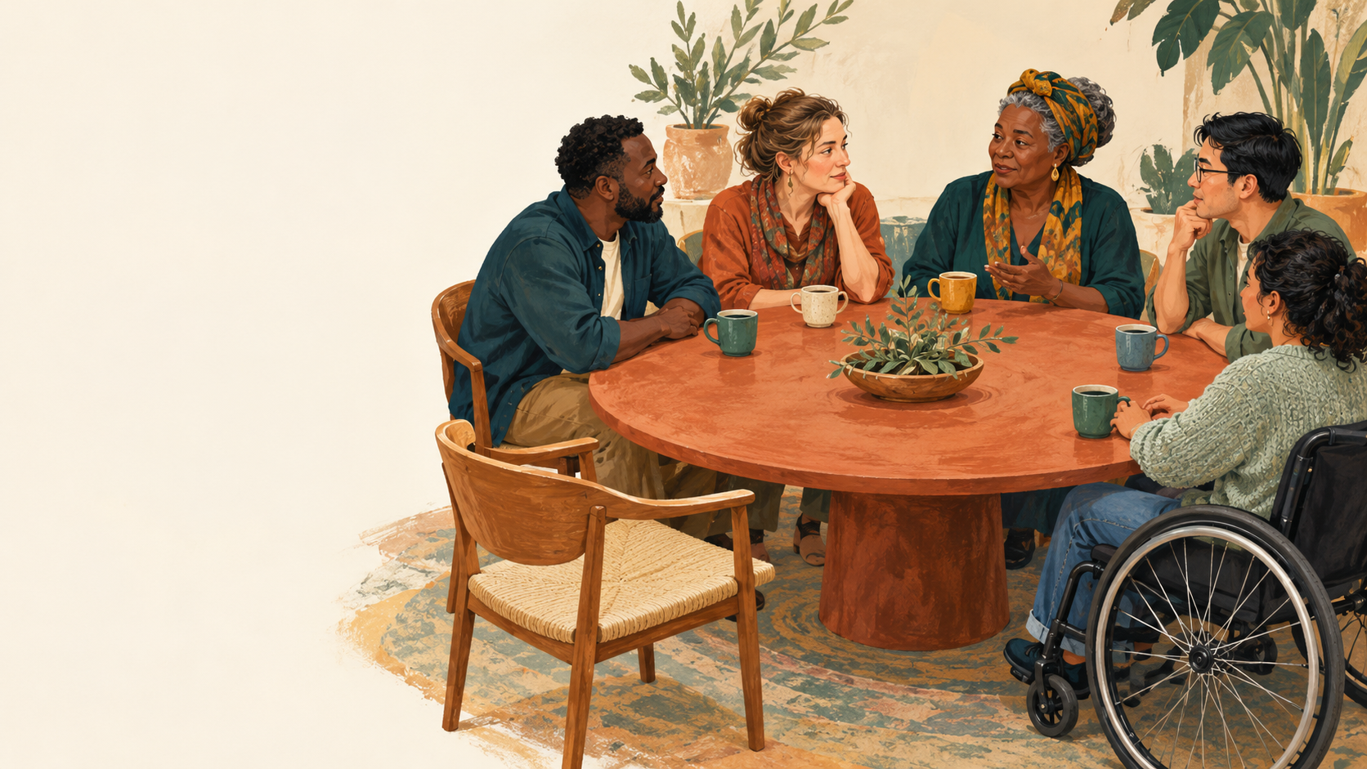
SAWUBONA
Who is
beside
you?
Loneliness, listening
and belonging
Lloyd Munyaviri
L2M Coaching
Notes:
WELCOME, 0-3 MINUTES. Welcome people by name when they choose to share it. Explain: Today we will explore the connections that help us feel seen and heard, practise listening, and choose one manageable next step. This is an adult coaching and community learning session, not a treatment group. No one has to share personal difficulties. Use the fictional examples throughout if preferred.

Slide 2
A room with choice
1
You can speak, write, draw or pass.
2
Share only what feels safe today.
3
Ask before giving advice.
4
Keep other people's stories private.
The facilitator will explain the limits of confidentiality.
SAWUBONA
02
Notes:
3-5 MINUTES. Read the agreements. Add: Please use first names or initials only on private worksheets. Do not photograph maps or record this session. We ask everyone to respect privacy, but cannot guarantee another participant's behaviour. If serious harm, abuse or safeguarding concerns arise, I may need to involve appropriate support under our local policy. I will explain what I need to do wherever possible. Show the quiet space and name the support lead. Participants may leave and rejoin. Never require physical contact or eye contact.

Slide 3
How connected do I feel today?
My private reflection
0
1
2
3
4
5
6
7
8
9
10
What would one point higher look like?
0 = I feel very disconnected 10 = I feel as connected as I need
SAWUBONA
03
Notes:
5-8 MINUTES. Workbook page 1. Ask for a private mark on a 0-10 line. Then: What helps you feel seen or heard? What would one point higher look like in daily life? Sharing the number is optional. This is a reflection prompt, not a clinical loneliness scale or a diagnostic measure. Do not rank people or interpret a low mark as evidence of risk. Return to the same wording at the end.

Slide 4
What we will practise
01
Notice the connection I need
02
Map the support available to me
03
Listen with permission
04
Choose one small next step
SAWUBONA
04
Notes:
8-9 MINUTES. Explain the four outcomes. By the end participants should be able to distinguish being alone from feeling lonely, identify one support option or a supported route to finding one, demonstrate permission and reflection, and make a realistic seven-day connection plan. No minimum number of friends or contacts is required.

Slide 5
Old sayings, thoughtful questions
“No person is an island”
“You cannot clap with one hand alone”
“A problem shared is a problem halved”
Who helps? What kind of help? What feels safe to share?
SAWUBONA
05
Notes:
9-12 MINUTES. These are familiar sayings used as discussion prompts, not evidence or rules. Ask: Which saying speaks to you? When might it fail to fit? Reframe the first as interdependence while respecting independence. The hands image is a metaphor for cooperation, not a judgement of physical ability. No clapping or physical demonstration is required. Explain that sharing can change how a burden feels, but does not guarantee a solution or literally halve a problem.

Slide 6
Alone, isolated or lonely?
SOLITUDE
SOCIAL ISOLATION
LONELINESS
Time alone that I choose and may enjoy.
Too few relationships, roles or interactions.
A painful gap between the connection I have and the connection I need.
A person can feel lonely in a busy room.
SAWUBONA
06
Notes:
12-15 MINUTES. Ask for neutral examples, not disclosures. Someone can live alone and feel connected, or have many contacts and still feel lonely. WHO defines social isolation in terms of few roles, relationships and interactions, and loneliness as a distressing mismatch between actual and wanted connection. Solitude wording is a plain-language teaching distinction. Source: WHO, Social connection Q&A, 30 June 2025. https://www.who.int/news-room/questions-and-answers/item/social-connection

Slide 7
Connection has several dimensions
WHO IS THERE?
WHAT SUPPORT?
HOW DOES IT FEEL?
People, roles and opportunities to meet.
Company, understanding or practical help.
Safe, respectful and welcome?
A larger circle can offer more options. The quality of connection matters.
SAWUBONA
07
Notes:
15-18 MINUTES. WHO describes structure, function and quality as dimensions of connection. Gallup reports links between close workplace friendships and engagement and business outcomes. These findings do not establish that adding people automatically makes someone happier. Ask: Which dimension needs attention for you? The coaching inference for this lesson is to seek manageable, safe support rather than a target contact count. Sources: WHO Q&A, 2025, https://www.who.int/news-room/questions-and-answers/item/social-connection ; Patel and Plowman, Gallup, updated 19 January 2024, https://www.gallup.com/workplace/397058/increasing-importance-best-friend-work.aspx

Slide 8
A possible pattern of disconnection
I feel disconnected
I expect rejection
Fewer chances to connect
I pull back
Where could a small, supported action interrupt this pattern?
SAWUBONA
08
Notes:
18-22 MINUTES. Present this as an illustrative coaching pattern, not a universal or validated psychological model. Workbook page 2. Ask: Does any part fit the fictional case or your experience? What else might be going on? Name external barriers too: shift work, language, cost, caring duties, disability, discrimination, transport, loss or unsafe relationships. Do not reduce loneliness to attitude or blame a participant for withdrawing. A smaller step or change in access may help.

Slide 9
Tariro's busy week
TARIRO
Messages arrive all day.
Tariro helps colleagues and family.
At night, there is nobody they feel able to call.
What might Tariro need before another invitation would help?
SAWUBONA
09
Notes:
22-26 MINUTES. Fictional scenario. Read it once and allow quiet thinking. In pairs, discuss: What do we know? What are we assuming? What might Tariro want: company, understanding, practical help or specialist support? What could make reaching out hard? Avoid diagnosing Tariro, assuming their gender, or prescribing a large social event. Ask participants to suggest a question they would ask Tariro.

Slide 10
The first bridge can be small
What I need
One safe invitation
A connection I can try
A person, a place or a service
“Would you have ten minutes for a catch-up this week?”
SAWUBONA
10
Notes:
26-30 MINUTES. Ask pairs to choose one possible bridge for Tariro. Examples: ask a trusted colleague for a short lunch, reconnect with someone familiar, visit a recurring low-cost group with a host's help, or ask a practitioner to help identify support. Say: You may start with a person, a place or a service. A no or delayed reply is information about that moment, not a measure of your worth. Return to what is within the person's control.

Slide 11
My support map
PEOPLE
I TRUST
PLACES
I CAN BELONG
ME
SKILLED OR
FORMAL SUPPORT
Use initials, symbols or roles. A possible connection can go on the map too.
SAWUBONA
11
Notes:
30-33 MINUTES. Introduce workbook page 3. This original Sawubona exercise uses three branches around ME, not a score or hierarchy of closeness. People: friend, chosen family, colleague, neighbour. Places: a walking group, community gathering, club, library or online group with good boundaries. Skilled or formal support: GP or local clinician, counsellor, social prescriber where available, safeguarding lead or other appropriate service. No category must be filled. A blank map is not a failure.

Slide 12
A map with room to grow
1
Add what already exists.
2
Mark what feels supportive.
3
Circle one connection to strengthen.
4
Add one possible route where a gap remains.
What do I need that this map does not yet offer?
SAWUBONA
12
Notes:
33-45 MINUTES. Workbook page 3. 5 minutes private mapping, 4 minutes optional pair reflection, 3 minutes whole-group debrief. Use S for supportive, ? for uncertain and B for a boundary needed; symbols accompany colour. Ask: Who listens? Who helps practically? Where can you take part without explaining everything? Which connection drains or frightens you? Keep the last question private. If no safe person comes to mind, offer a private check-in and help find a hosted group or qualified service. Never tell someone to approach an unsafe relative. Participants keep their maps.

Slide 13
Pause
Five minutes to rest
Water, quiet or movement if you choose
SAWUBONA
13
Notes:
45-50 MINUTES. Announce the return time. Offer a quiet option without conversation. Check privately with anyone who asked for support. Do not infer distress from silence or leaving. Keep a co-facilitator or named support contact available where possible.

Slide 14
Permission comes first
“Is now a good time?”
“Would you like me to listen?”
“What would feel useful?”
The person chooses what to share and how much.
SAWUBONA
14
Notes:
50-53 MINUTES. Demonstrate a short opening. Speaker: I have felt a bit disconnected lately. Listener: Thank you for telling me. Is now a good time for a few minutes? Would it help if I listened, or is there another kind of support you want? Ask before giving advice, introducing another person or passing on information, except when safeguarding duties require action. Respect a no. No one owes a disclosure in return for being included.

Slide 15
Sawubona listening
INVITE
Offer time and choice.
LISTEN
Allow pauses. Stay with their meaning.
REFLECT
“Have I understood you?”
AGREE
Ask what happens next.
A useful question: “What would help you feel less alone with this?”
SAWUBONA
15
Notes:
53-56 MINUTES. This four-step sequence is an original facilitation aid for this resource, not an accredited or clinically validated model. Demonstrate: It sounds as though you are carrying a lot and missing someone to talk with. Have I understood? Let the speaker correct you. Avoid fixing, interrogation, forced positivity, making it about yourself, minimising or promising secrecy. Validation recognises their experience without requiring agreement with every belief or action. Agree only a next step that both people can sustain.

Slide 16
Three roles, one conversation
SPEAKER
LISTENER
OBSERVER
Choose a mild everyday topic or use Tariro.
Ask permission, listen and reflect.
Notice choice, attention and consent.
Three rounds of 3 minutes. Rotate roles each round.
SAWUBONA
16
Notes:
56-65 MINUTES. Each round: 90 seconds speaking and listening, 30 seconds reflecting and checking, 30 seconds observer feedback, 30 seconds rotate. Total 9 minutes. Use a timer and give a 30-second warning. Observer checklist: asked permission; allowed space without interruption; reflected tentatively and checked; asked what support was wanted; respected a pass or boundary. No personal story details in feedback. Everyone may pass, write instead, or observe only. A pair can alternate speaker/listener with private self-observation. Avoid pairing a manager and direct report when choice would feel constrained.

Slide 17
What helped me feel heard?
01
What did the listener do?
02
What felt uncomfortable or missing?
03
What will I practise again?
Discuss the listening process. Keep the speaker's story private.
SAWUBONA
17
Notes:
65-68 MINUTES. Invite learning about process only. Ask participants to name a specific action rather than label a listener good or bad. Examples: You waited, you asked before advising, you checked what I meant. If someone felt exposed, acknowledge it, allow a pause, offer a private check-in and revisit choice. Use workbook page 4 to note one listening habit and one boundary.

Slide 18
Sharing the load
A CONCERN
I AM CARRYING
Someone to hear me
Someone to help with a task
Someone with relevant expertise
Share only what each person needs to know.
The problem may remain. The support around it can change.
SAWUBONA
18
Notes:
68-72 MINUTES. Workbook page 5. Use a mild fictional example: overwhelmed by a house move. Ask what a friend can hear, what a neighbour might help with and what a professional may need to advise on. Let participants keep a real concern unnamed. Shared support can offer perspective, company or practical action, while a problem may require specialist help. Two people or a wider circle can distribute support with consent, but one person should not become everyone's sole support. Do not pass someone's story to a group without their permission.

Slide 19
A healthy boundary protects connection
“I can listen for ten minutes.”
“I cannot keep you safe on my own.”
“Shall we find the right support together?”
Choose a safe person, a suitable time and a level of detail that feels right.
SAWUBONA
19
Notes:
72-75 MINUTES. Explain role limits. Friends and coaches can support connection but cannot substitute for qualified care. If someone describes persistent distress or difficulty functioning, encourage appropriate professional support and offer help accessing it. If there is immediate danger, use local emergency help and the agreed safeguarding procedure. Do not investigate abuse or promise absolute confidentiality. For unsafe relationships, prioritise safety and independent specialist support rather than a joint discussion with the person causing harm. No helpline numbers are supplied because this resource is intended for local adaptation.

Slide 20
When reaching out feels difficult
“I do not want to be a burden.”
Ask for a small, specific amount of time.
“I do not know anyone.”
Ask a host or service to help with a first introduction.
“They have not replied.”
Choose another safe option and give yourself time.
What practical barrier could a host, employer or community help remove?
SAWUBONA
20
Notes:
75-78 MINUTES. Workbook page 6. Do not insist the barrier is an unhelpful belief. Explore cost, language, transport, discrimination, caring duties, fatigue, disability access and availability. Possible supports include a free venue, quiet hour, accessible transport, translated invitation, phone alternative, a familiar companion or predictable meeting time. A failed attempt is information. An alternative route can be smaller or better supported.

Slide 21
One connection in the next seven days
WHO OR WHERE?
A safe person, group or service.
WHAT AND WHEN?
One specific, manageable invitation.
IF IT DOES NOT WORK?
A second route or a smaller step.
HOW WILL I REVIEW?
Notice what helped and what I need next.
Optional: agree one check-in, with permission and a clear date.
SAWUBONA
21
Notes:
78-85 MINUTES. Workbook page 6. Give 4 minutes to write a plan, 2 minutes optional sharing and 1 minute to refine. Example: On Tuesday I will ask my neighbour whether they would like a 15-minute walk on Saturday. If they are unavailable, I will ask the local group host about joining once. No sending messages during the session is required. Participants choose whether to use a buddy and what may be shared. Do not create a group chat or contact list without explicit consent.

Slide 22
What is different now?
01
How connected do I feel today?
02
What helped me feel seen or heard?
03
What is my next small step?
A steady score is allowed. Support can take time to build.
SAWUBONA
22
Notes:
85-90 MINUTES. Return to workbook page 1 and the same 0-10 prompt. Give 1 minute for private reflection, 2 minutes for optional closing words, 1 minute to recap the person's chosen next step and 1 minute to remind people of local support. A change in the score is not proof of impact or treatment. Ask: What is useful even if the number is the same? Offer follow-up with permission. Close: You can choose how connection looks for you. You deserve to be seen and heard.

Slide 23
A place beside you
Who could sit beside you this week?
Who could you gently invite?
Sawubona. I see you. I hear you.
SAWUBONA
23
Notes:
CLOSING VISUAL within the final 5 minutes. Let this remain on screen as people finish. Invite each person to take their own worksheet. Collect only anonymous feedback if agreed. Do not retain support maps or personal concerns. This original Sawubona resource was developed for Lloyd Munyaviri / L2M Coaching. Visual metaphor and illustration are original to this pack.

Slide 24
Evidence and inspiration
WHO Social connection Q&A (2025)
WHO Commission on Social Connection report (2025)
Gallup workplace friendship research (updated 2024)
Inspiration: Joshua Freedman / Six Seconds community post
Full links and source notes appear in the facilitator guide.
Activities and layouts are original. These sources do not endorse this lesson.
SAWUBONA
24
Notes:
REFERENCE SLIDE, not an additional timed teaching block. WHO Q&A: https://www.who.int/news-room/questions-and-answers/item/social-connection . WHO report: https://www.who.int/publications/i/item/978240112360 . Gallup, Patel and Plowman: https://www.gallup.com/workplace/397058/increasing-importance-best-friend-work.aspx . Concept inspiration only: the two user-supplied Joshua Freedman / Six Seconds resources, including How far you can go. Their artwork, footprint composition and wording have not been reproduced. Traditional sayings appear as familiar prompts without an asserted origin. The lesson's worksheets, fictional case, facilitation sequence and diagrams are original. AI-generated cover illustration is conceptual, not a photograph of a Sawubona event. This lesson is not affiliated with or endorsed by WHO, Gallup or Six Seconds.

